Slide 1
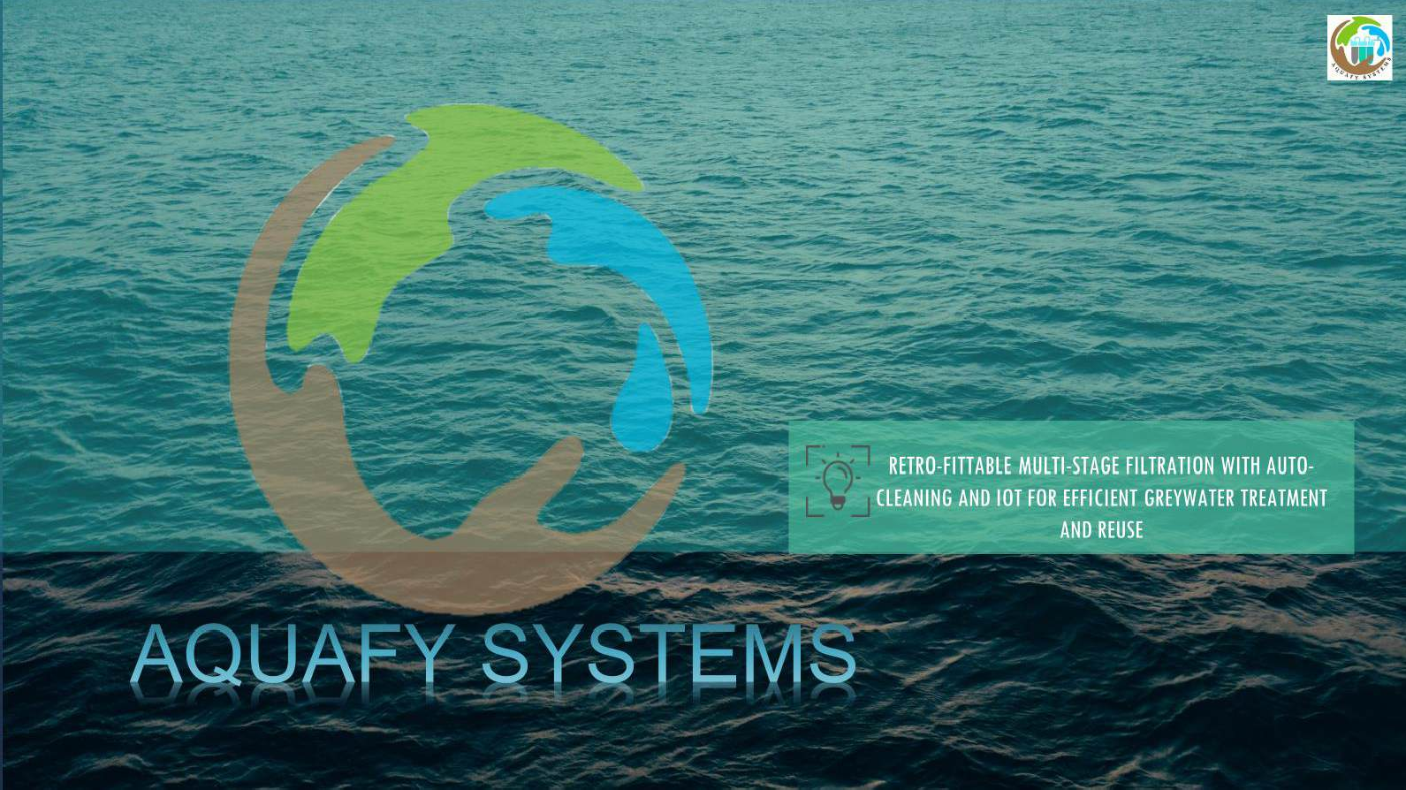


Innovative Greywater Filtration system: A Sustainable Solution for Water Reuse
Where Innovation meets Impact
SARASWAT DAS

Slide 2

Table of Contents
1
The Overview
2
Problem
3
Objective
4
Methodology
5
Solution & Innovation
6
Market & Opportunity

Slide 3
The Overview

Slide 4


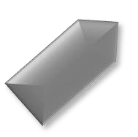


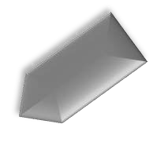

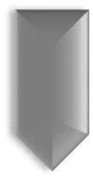
Objective
To treat greywater effectively for reuse in various non-potable applications.
Scalability
Its modular design allows for easy expansion or customization to meet different water reuse needs.
Functionality
This multistage filtration process ensures that the greywater is thoroughly.
Accessibility
Our system is designed to be accessible and easy to install, making it suitable for a wide range of users and settings.
Tech Integration
smart monitoring system (WQQM system), which provides real-time data on water quality parameters.
Impact
Significant impact on reducing water footprint
Alert System
Dedicated Alert System for notifying
users about issues or maintenance
and promoting sustainable water
management practices.
Versatility
The design of our system makes it versatile and
suitable for various non-potable uses.

Slide 5
The Problem

Slide 6
Problem & Pain Points:
Key Elements:
Brief Tech Involved:
Innovation & Solution:
Problem:
Water scarcity and contamination in India.
Concept:
A decentralized Grey Water Treatment methodology
Affordable Pricing:
Priced at 20,000 rupees, making it accessible.
Kitchen Wastewater Purification:
Addresses contamination concerns.
Decentralized System:
Targets areas with limited
centralized treatment
IoT Integration:
Real-time monitoring of water quality.
Alert system for timely
App Development:
Supports real-time monitoring through a user-friendly app.
Water Treatment Technology:
Advance water filtration unit for kitchen wastewater purification
Pain Points:
Limited access to centralized water treatment.
Health impacts due to contaminated water.
High costs of existing water solutions.
Targets grey wastewater, a significant contamination source.

Slide 7
Objective

Slide 8



Water Conservation
Objective of our innovative greywater
filtration system is to provide a sustainable solution for treating greywater and making it suitable for
Environmental sustainability
Cost Effectiveness
Health and Safety
Scalability
various non-potable uses.
Education and Awareness

Slide 9
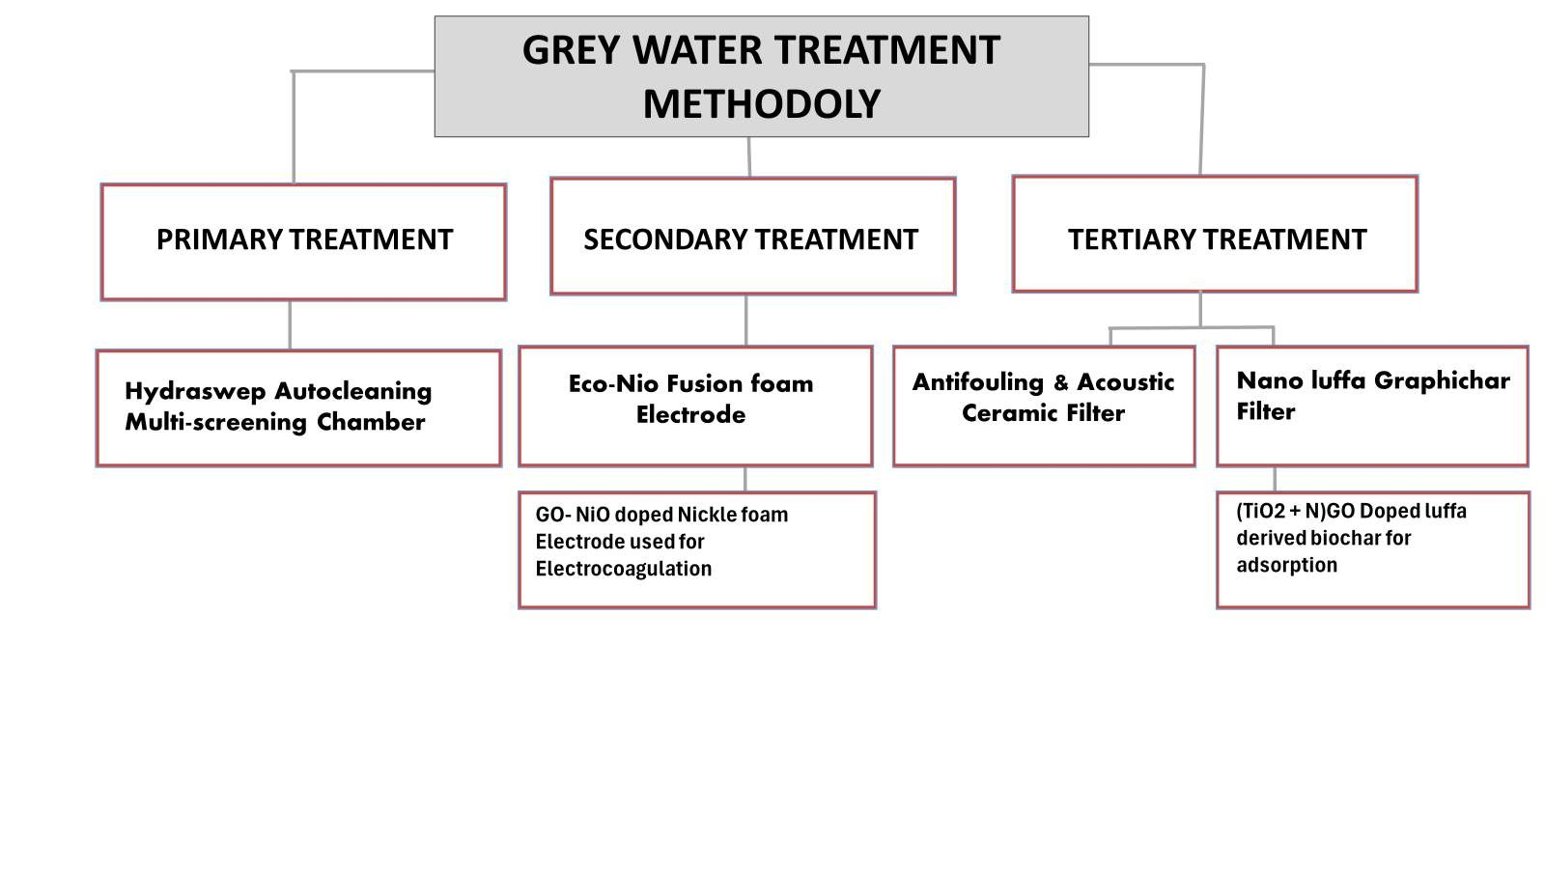




GREY WATER TREATMENT METHODOLY
PRIMARY TREATMENT
SECONDARY TREATMENT
TERTIARY TREATMENT
Hydraswep Autocleaning Multi-screening Chamber
Eco-Nio Fusion foam
Antifouling & Acoustic
Ceramic Filter
Nano luffa Graphichar Filter
Electrode
GO- NiO doped Nickle foam
(TiO2 + N)GO Doped luffa derived biochar for adsorption
Electrode used for
Electrocoagulation

Slide 10
Solution
& Innovation

Slide 11
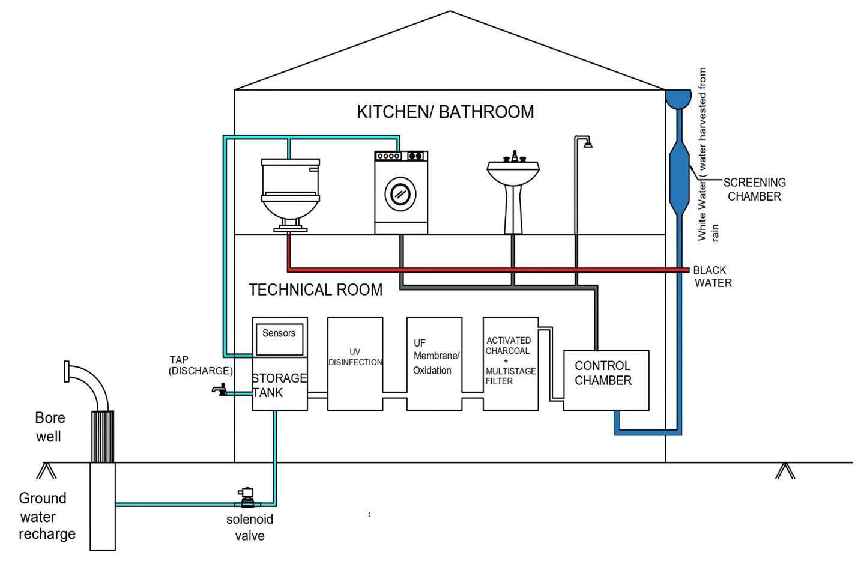
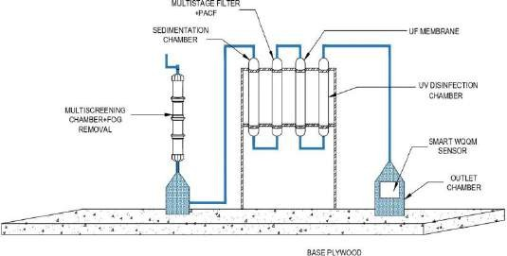
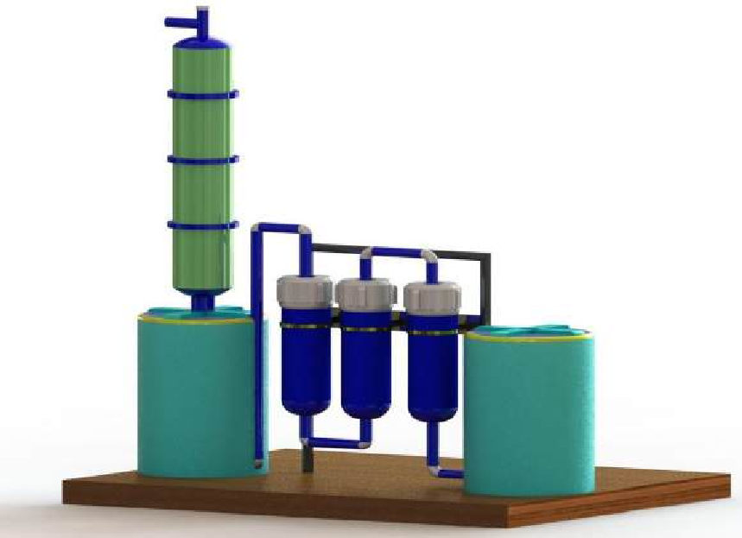
Aquafy Grey Water Treatment Unit.
2-D REPRESENTATION
GRAY WATER TREATEMENT(FILTRATION UNIT)
3-D REPRESENTATION
WATER TREATEMENT PLAN

Slide 12
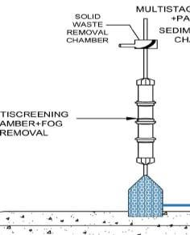
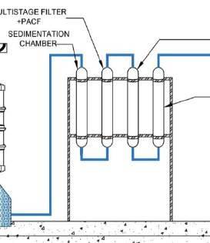
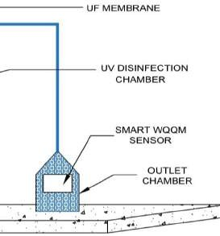
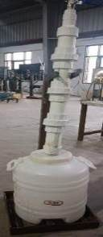
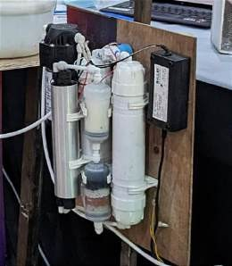
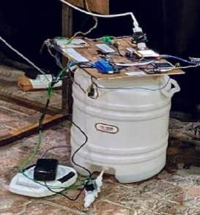
Filtration Unit System

Slide 13
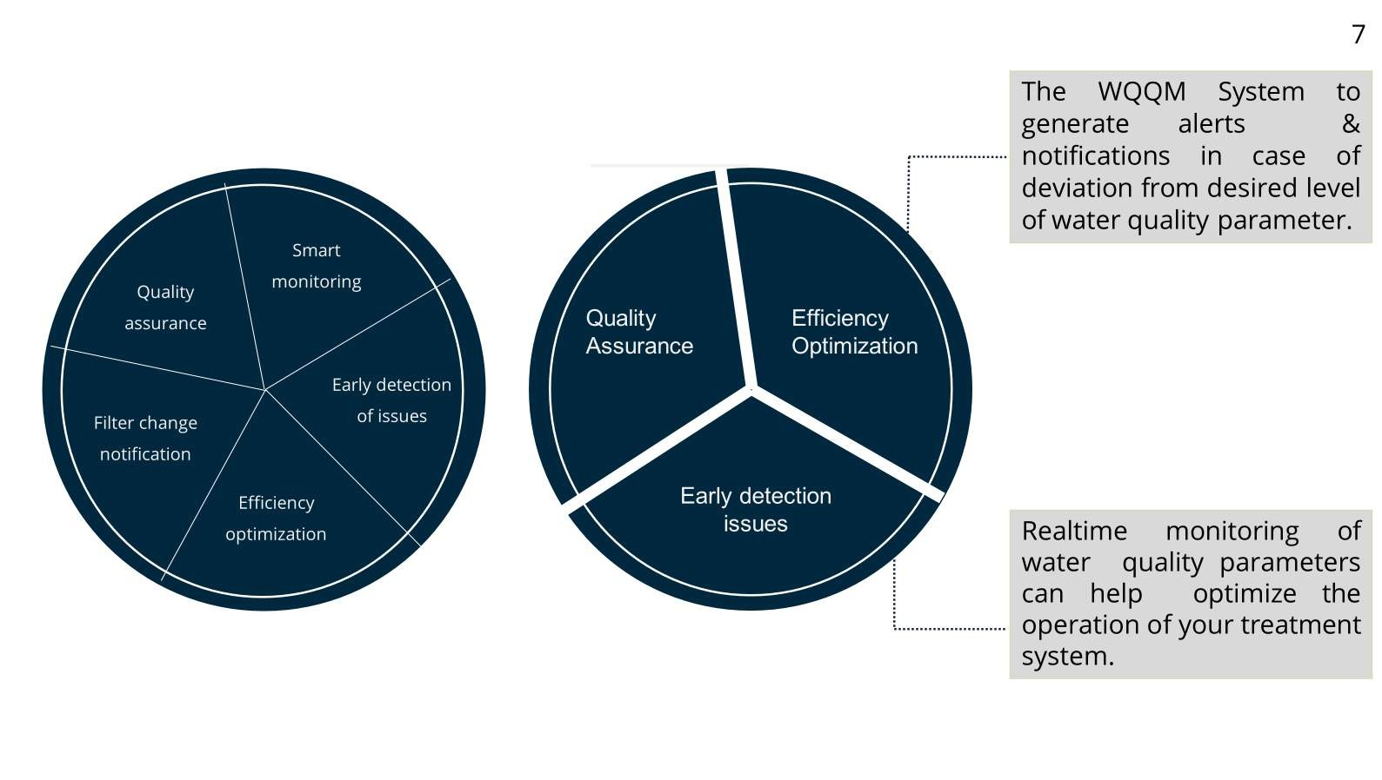
The WQQM System to
generate alerts &
7
notifications in case of deviation from desired level of water quality parameter.
Quality assurance
Smart monitoring
Early detection of issues
Efficiency optimization
Filter change notification
Quality Assurance
Efficiency Optimization
Early detection issues
Realtime monitoring of water quality parameters can help optimize the operation of your treatment system.

Slide 14
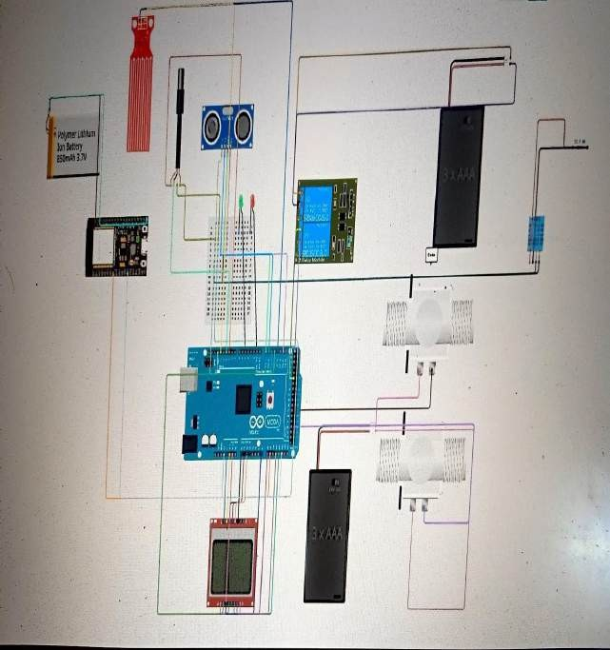
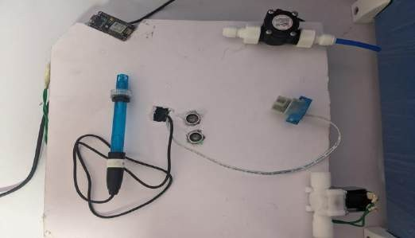
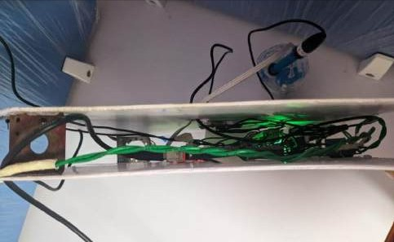
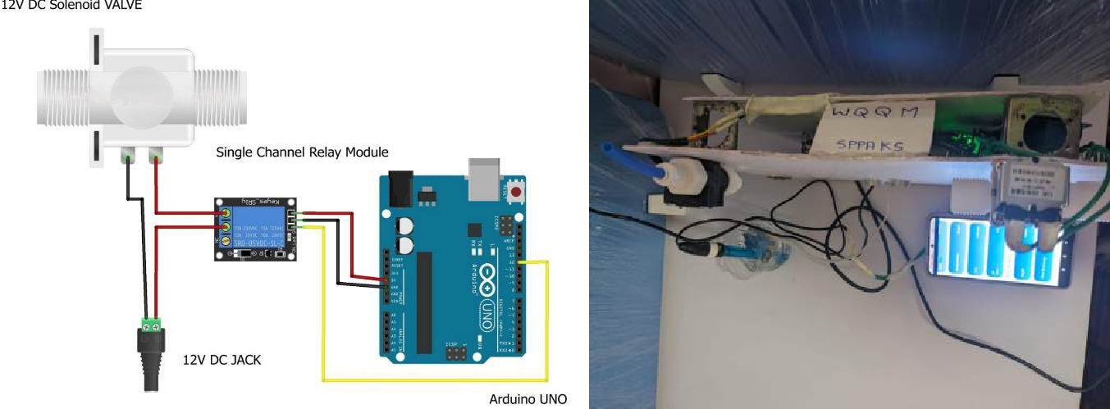
SMART WATER QUALITY AND QUANTITY MONITORING SYSTEM (Embedded IOT)
Mobile app

Slide 15


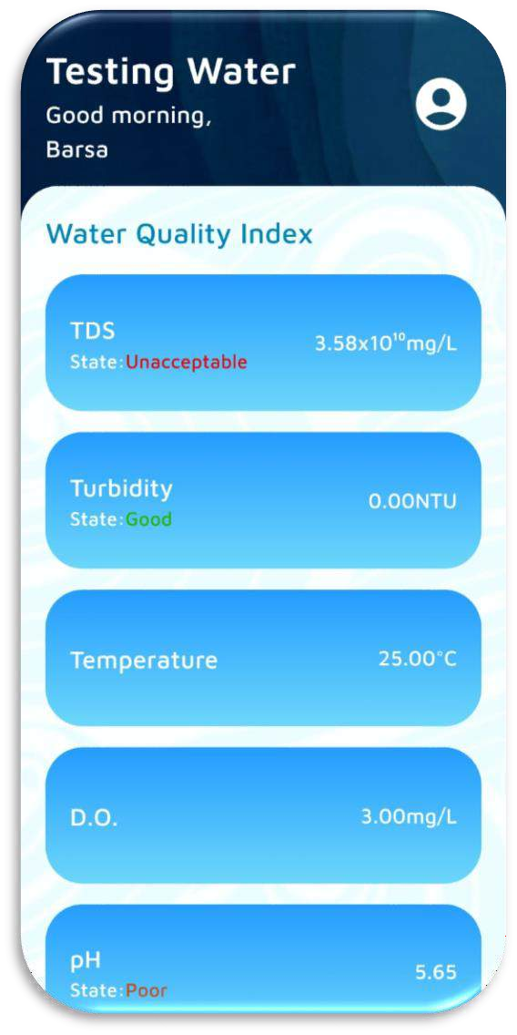
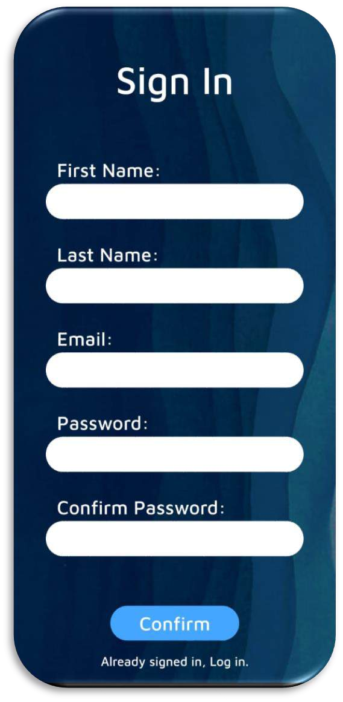
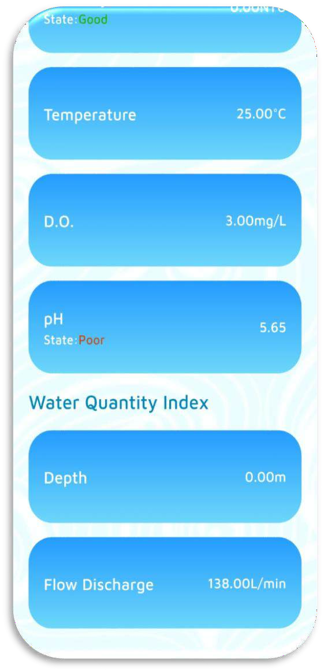

U I Interface of AQUAFY App

Slide 16
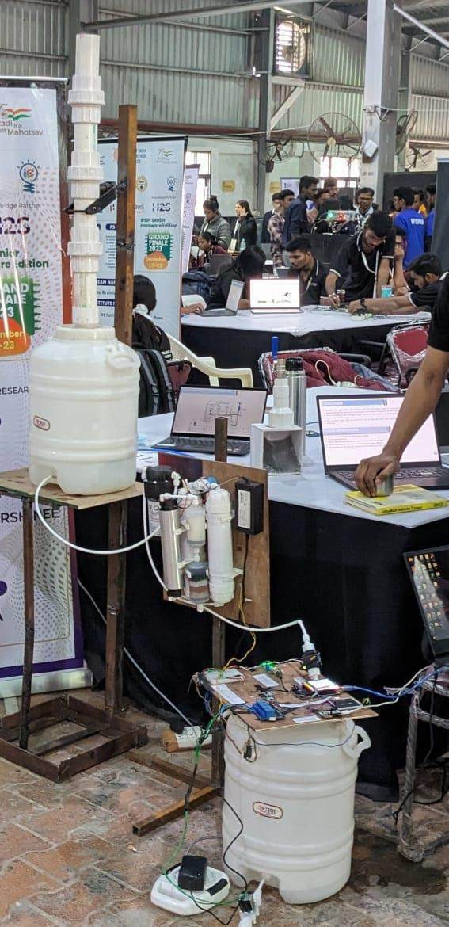
Cost-Effective Retrofitting
Sustainability and Resources Optimization
Decentralized approach
Smart Monitoring and Alerts for Timely Intervention
Remote Maintenance Integration for Efficiency
Environmental Friendliness
Long-Term Sustainability and Predictive
Capabilities for CSR activities as well.

Slide 17




Community impact
Energy savings
IMPACT
Environmental sustainability
Water conservation
Cost savings

Slide 18
Competitive Landscape

Slide 19






Competitors Overview
EnviroWay
Siemens
Aqua Mech
Extensive Service Network
Operationally Expensive
Not suitable for small scale
Industrial-scale solutions
High setup cost
Limited focus on affordability.
AI for predictive
analysis
High complexity
High cost barriers.
Green chemistry
Sustainable Solutions
Lacks Affordability
Real-time
Advanced industrial hydronic systems
Not affordable
for small scale
deployment
Advanced
filtration
High maintenance cost
Limited smart
features
monitoring
GE Vernova
Evoqua
Thermax

Slide 20
CONCLUSION
Cost effective solution
Priced at Rs- 25,000/- significantly more affordable than competitors
Ideal for small scale and individual use
Real-time Monitoring
IoT integration enables real-time tracking of Ph, TDS, turbidity, BOD 7 COD for proactive maintenance
Aquafy systems offers a uniquely
affordable, smart, and efficient solution in a market dominated by costlier and less versatile competitors, making it ideal for
Smart Technology
Machine learning enhances predictive maintenance,
widespread adoption in resource-
constrained environments.
Efficient treatment
Innovative self-cleaning chamber,
electrocoagulation units, and anti-fouling membranes ensure superior water purification with minimal manual intervention.
automated reporting, and
water quality monitoring.

Slide 21
Business Model

Slide 22
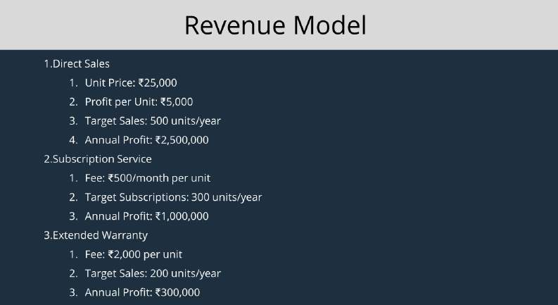
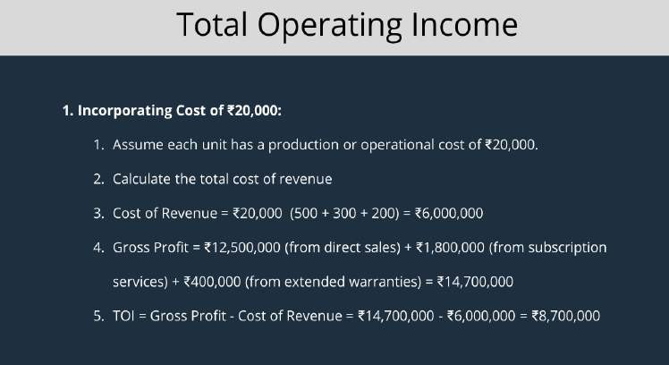
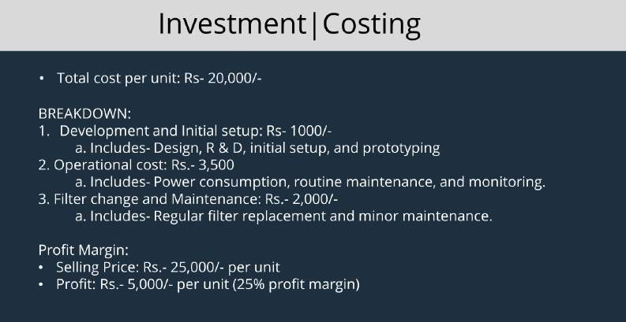

Slide 23


